Slide 1
Parallel Iterative Matrix Algorithms
CS121 Parallel Computing
Fall 2024

Slide 2
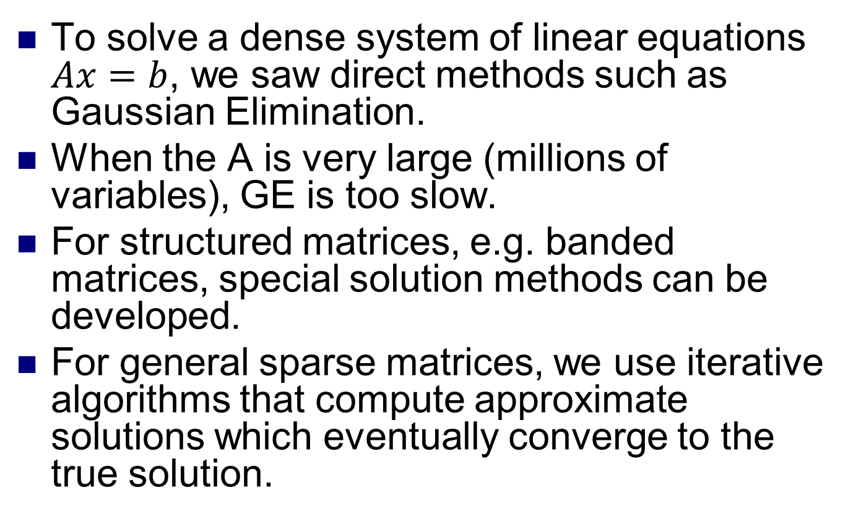
Iterative matrix algorithms
To solve a dense system of linear equations $Ax=b$, we saw direct methods such as Gaussian Elimination.
When the A is very large (millions of variables), GE is too slow.
For structured matrices, e.g. banded matrices, special solution methods can be developed.
For general sparse matrices, we use iterative algorithms that compute approximate solutions which eventually converge to the true solution.

Slide 3
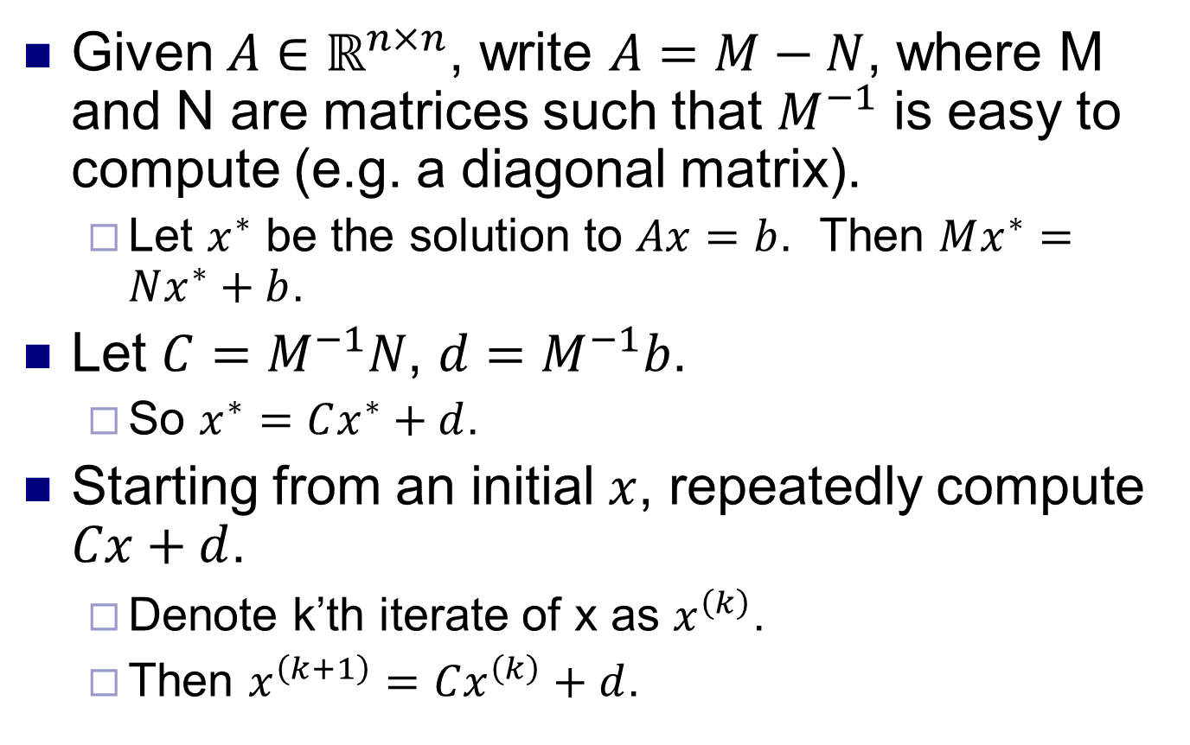
Iterative matrix algorithms
Given $A∈ℝ^{n×n}$, write $A=M−N$, where M and N are matrices such that $M^{−1}$ is easy to compute (e.g. a diagonal matrix).
Let $x^{∗}$ be the solution to $Ax=b$. Then $Mx^{∗}=Nx^{∗}+b$.
Let $C=M^{−1}N$, $d=M^{−1}b$.
So $x^{∗}=Cx^{∗}+d$.
Starting from an initial $x$, repeatedly compute $Cx+d$.
Denote k’th iterate of x as $x^{\left(k\right)}$.
Then $x^{\left(k+1\right)}=Cx^{\left(k\right)}+d$.

Slide 4
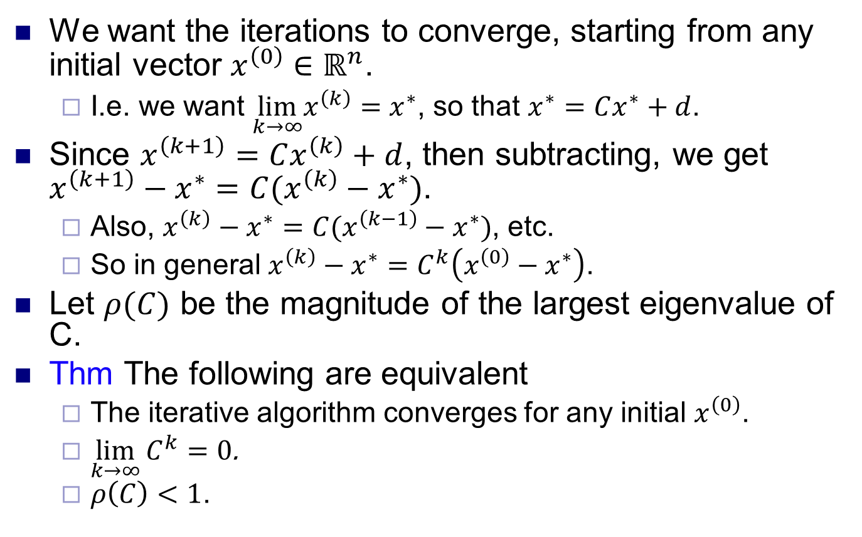
Convergence criteria
We want the iterations to converge, starting from any initial vector $x^{\left(0\right)}∈ℝ^{n}$.
I.e. we want $\lim_{k→∞}x^{\left(k\right)}=x^{∗}$, so that $x^{∗}=Cx^{∗}+d$.
Since $x^{\left(k+1\right)}=Cx^{\left(k\right)}+d$, then subtracting, we get $x^{\left(k+1\right)}−x^{∗}=C(x^{\left(k\right)}−x^{∗})$.
Also, $x^{\left(k\right)}−x^{∗}=C(x^{\left(k−1\right)}−x^{∗})$, etc.
So in general $x^{\left(k\right)}−x^{∗}=C^{k}\left(x^{\left(0\right)}−x^{∗}\right)$.
Let $ρ(C)$ be the magnitude of the largest eigenvalue of C.
Thm The following are equivalent
The iterative algorithm converges for any initial $x^{\left(0\right)}$.
$\lim_{k→∞}{C^{k}=0}$.
$ρ\left(C\right)<1$.

Slide 5
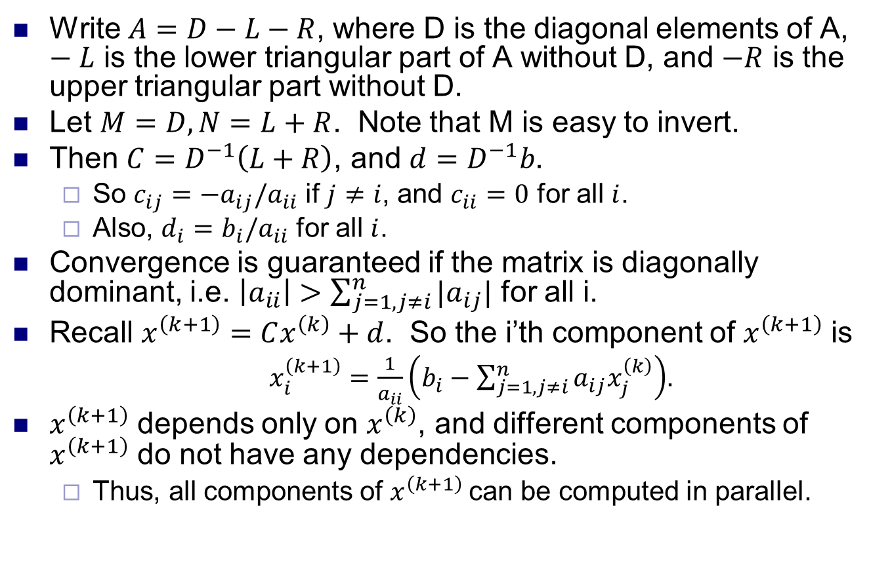
Jacobi method
Write $A=D−L−R$, where D is the diagonal elements of A, $−L$ is the lower triangular part of A without D, and $−R$ is the upper triangular part without D.
Let $M=D, N=L+R$. Note that M is easy to invert.
Then $C=D^{−1}\left(L+R\right)$, and $d=D^{−1}b$.
So $c_{ij}=−a_{ij}/a_{ii}$ if $j≠i$, and $c_{ii}=0$ for all $i$.
Also, $d_{i}=b_{i}/a_{ii}$ for all $i$.
Convergence is guaranteed if the matrix is diagonally dominant, i.e. $\left|a_{ii}\right|>\sum_{j=1,j≠i}^{n}{|a_{ij}|}$ for all i.
Recall $x^{\left(k+1\right)}=Cx^{\left(k\right)}+d$. So the i’th component of $x^{\left(k+1\right)}$ is
$x_{i}^{\left(k+1\right)}=\frac{1}{a_{ii}}\left(b_{i}−\sum_{j=1,j≠i}^{n}{a_{ij}x_{j}^{\left(k\right)}}\right)$.
$x^{\left(k+1\right)}$ depends only on $x^{\left(k\right)}$, and different components of $x^{\left(k+1\right)}$ do not have any dependencies.
Thus, all components of $x^{\left(k+1\right)}$can be computed in parallel.

Slide 6
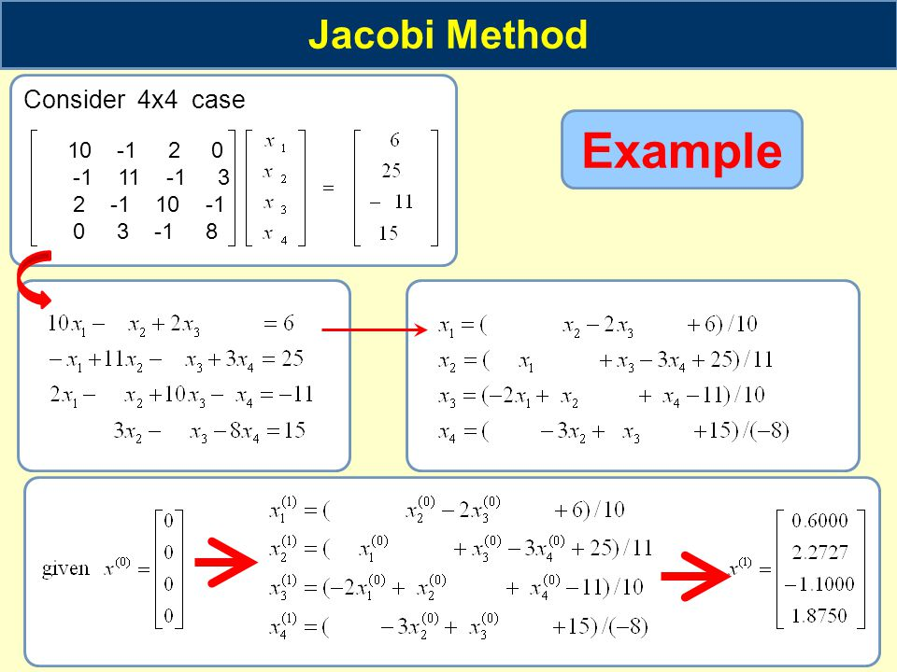
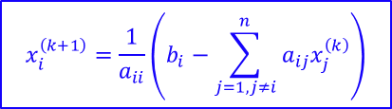
Jacobi method example
$$x_{i}^{\left(k+1\right)}=\frac{1}{a_{ii}}\left(b_{i}−\sum_{j=1,j≠i}^{n}{a_{ij}x_{j}^{\left(k\right)}}\right)$$
Source: https://slideplayer.com/slide/3276935/

Slide 7
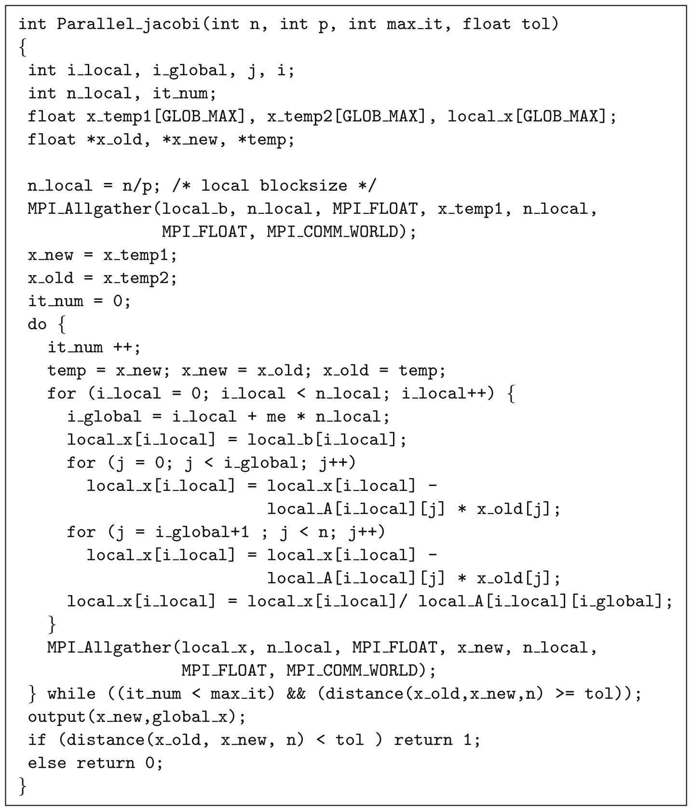
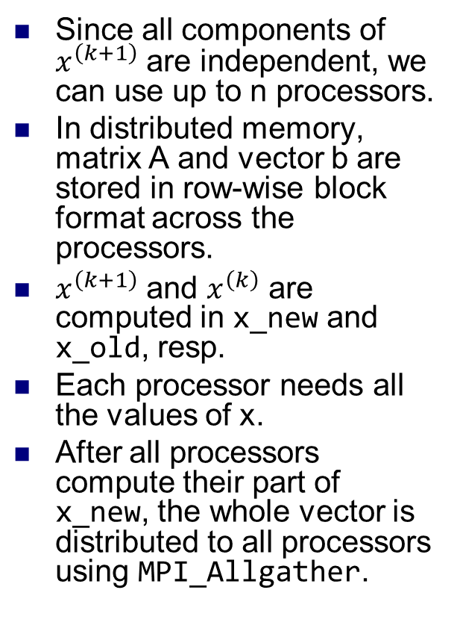
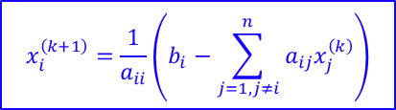
Parallel Jacobi method
$$x_{i}^{\left(k+1\right)}=\frac{1}{a_{ii}}\left(b_{i}−\sum_{j=1,j≠i}^{n}{a_{ij}x_{j}^{\left(k\right)}}\right)$$
Since all components of $x^{\left(k+1\right)}$ are independent, we can use up to n processors.
In distributed memory, matrix A and vector b are stored in row-wise block format across the processors.
$x^{\left(k+1\right)}$ and $x^{\left(k\right)}$ are computed in x_new and x_old, resp.
Each processor needs all the values of x.
After all processors compute their part of x_new, the whole vector is distributed to all processors using MPI_Allgather.
Source: Parallel Programming for Multicore and Cluster Systems, Rauber and Runger

Slide 8
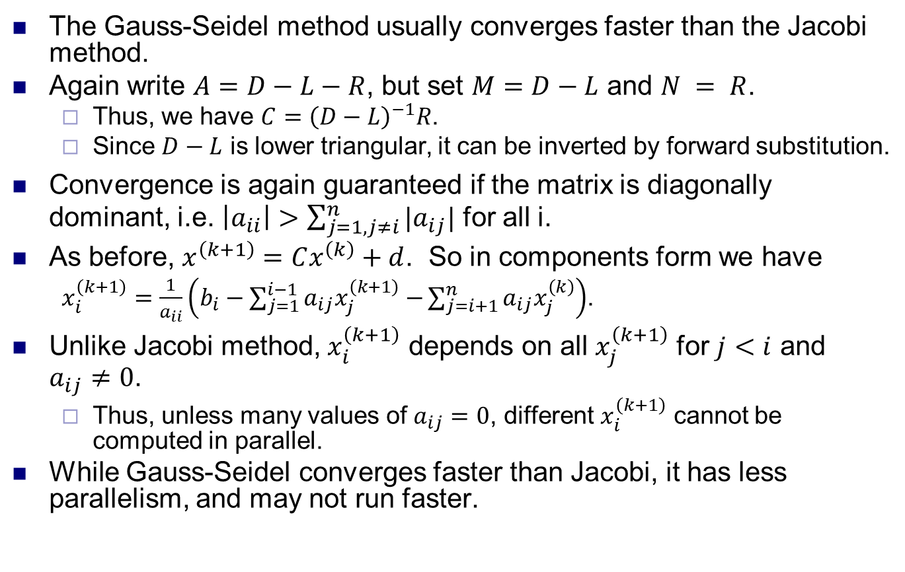
Gauss-Seidel method
The Gauss-Seidel method usually converges faster than the Jacobi method.
Again write $A=D−L−R$, but set $M=D−L$ and $N = R$.
Thus, we have $C={\left(D−L\right)}^{−1}R$.
Since $D−L$ is lower triangular, it can be inverted by forward substitution.
Convergence is again guaranteed if the matrix is diagonally dominant, i.e. $\left|a_{ii}\right|>\sum_{j=1,j≠i}^{n}{|a_{ij}|}$ for all i.
As before, $x^{\left(k+1\right)}=Cx^{\left(k\right)}+d$. So in components form we have
$x_{i}^{\left(k+1\right)}=\frac{1}{a_{ii}}\left(b_{i}−\sum_{j=1}^{i−1}{a_{ij}x_{j}^{\left(k+1\right)}−}\sum_{j=i+1}^{n}{a_{ij}x_{j}^{\left(k\right)}}\right)$.
Unlike Jacobi method, $x_{i}^{\left(k+1\right)}$ depends on all $x_{j}^{\left(k+1\right)}$ for $j<i$ and $a_{ij}≠0$.
Thus, unless many values of $a_{ij}=0$, different $x_{i}^{\left(k+1\right)}$ cannot be computed in parallel.
While Gauss-Seidel converges faster than Jacobi, it has less parallelism, and may not run faster.

Slide 9
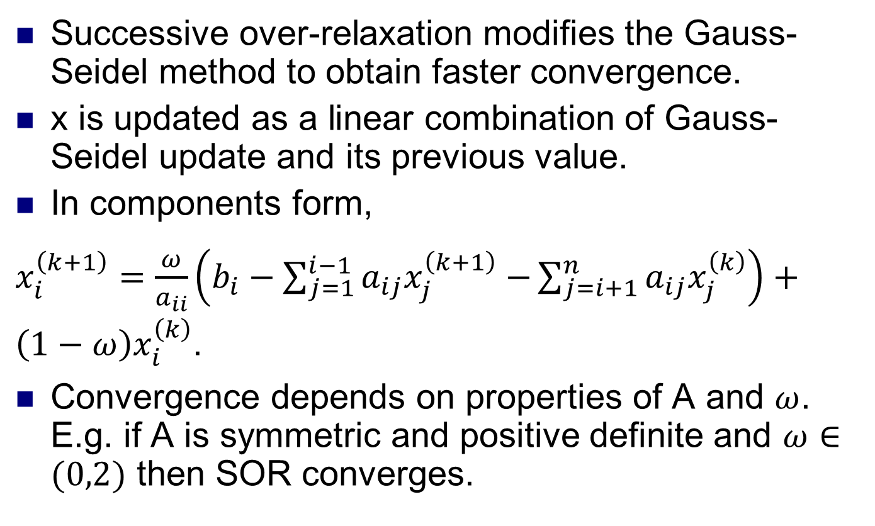
SOR method
Successive over-relaxation modifies the Gauss-Seidel method to obtain faster convergence.
x is updated as a linear combination of Gauss-Seidel update and its previous value.
In components form,
$x_{i}^{\left(k+1\right)}=\frac{ω}{a_{ii}}\left(b_{i}−\sum_{j=1}^{i−1}{a_{ij}x_{j}^{\left(k+1\right)}−}\sum_{j=i+1}^{n}{a_{ij}x_{j}^{\left(k\right)}}\right)+\left(1−ω\right)x_{i}^{\left(k\right)}$.
Convergence depends on properties of A and $ω$. E.g. if A is symmetric and positive definite and $ω∈(0,2)$ then SOR converges.

Slide 10
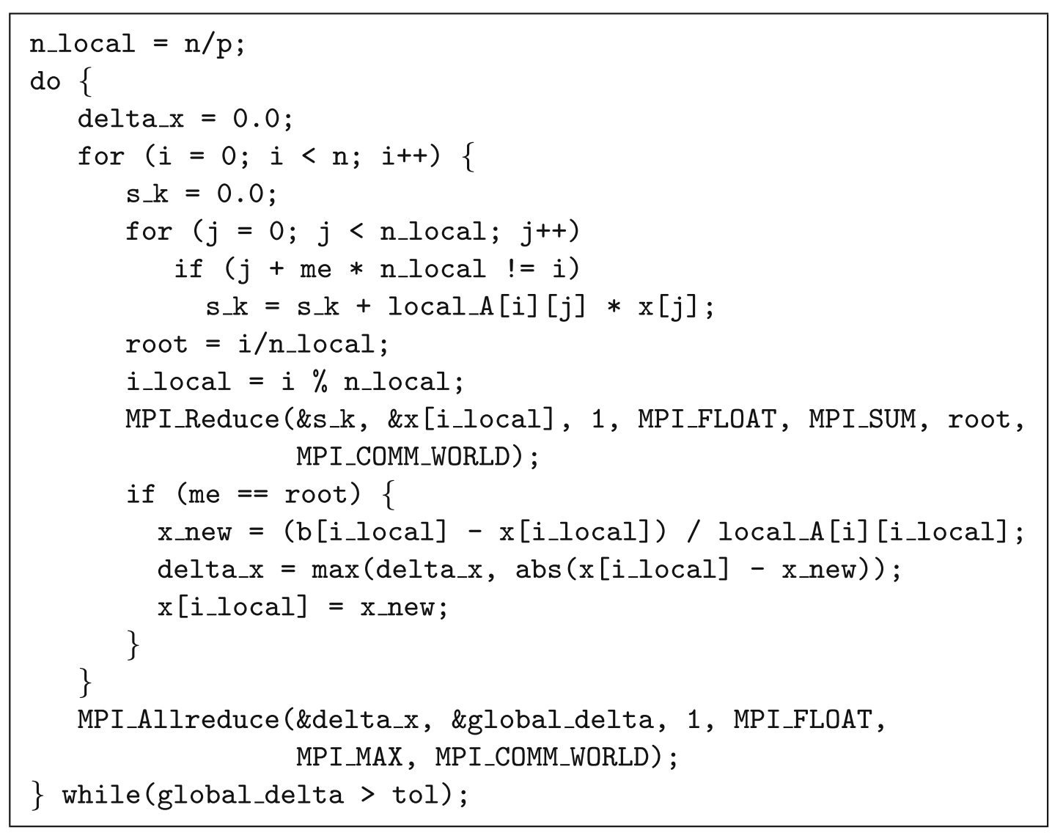
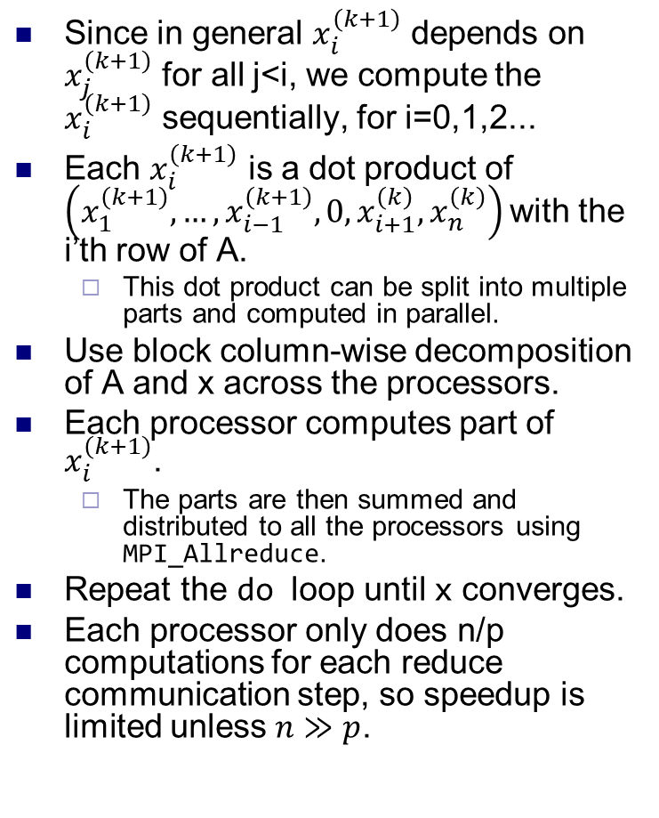
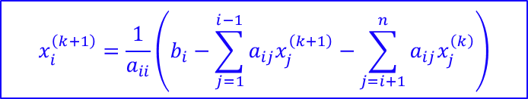
Parallel Gauss-Seidel method
Since in general $x_{i}^{\left(k+1\right)}$ depends on $x_{j}^{\left(k+1\right)}$ for all j<i, we compute the $x_{i}^{\left(k+1\right)}$ sequentially, for i=0,1,2...
Each $x_{i}^{\left(k+1\right)}$ is a dot product of $\left(x_{1}^{\left(k+1\right)},…,x_{i−1}^{\left(k+1\right)},0,x_{i+1}^{\left(k\right)}, x_{n}^{\left(k\right)}\right)$with the i’th row of A.
This dot product can be split into multiple parts and computed in parallel.
Use block column-wise decomposition of A and x across the processors.
Each processor computes part of $x_{i}^{\left(k+1\right)}$.
The parts are then summed and distributed to all the processors using MPI_Allreduce.
Repeat the do loop until x converges.
Each processor only does n/p computations for each reduce communication step, so speedup is limited unless $n≫p$.
$$x_{i}^{\left(k+1\right)}=\frac{1}{a_{ii}}\left(b_{i}−\sum_{j=1}^{i−1}{a_{ij}x_{j}^{\left(k+1\right)}−}\sum_{j=i+1}^{n}{a_{ij}x_{j}^{\left(k\right)}}\right)$$

Slide 11
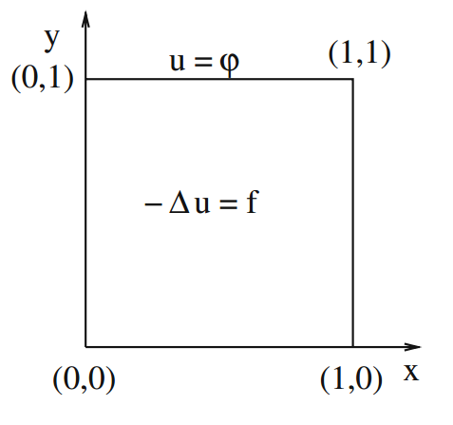
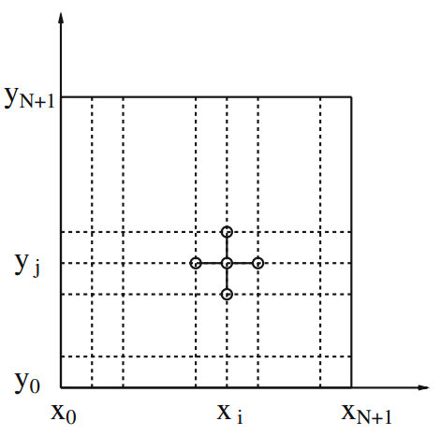
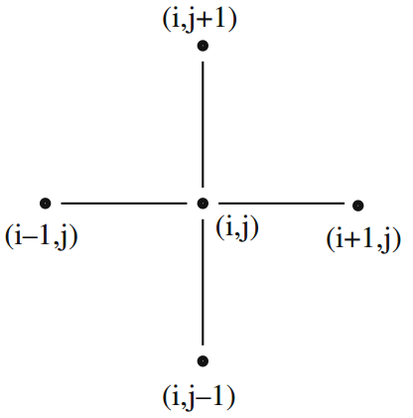
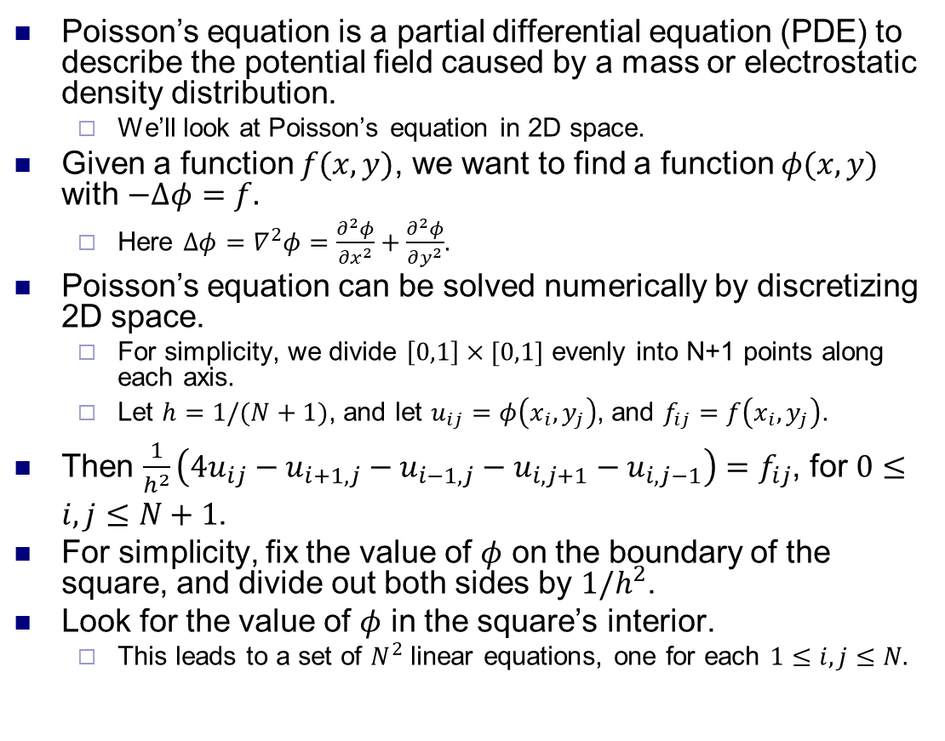
Poisson’s equation
Poisson’s equation is a partial differential equation (PDE) to describe the potential field caused by a mass or electrostatic density distribution.
We’ll look at Poisson’s equation in 2D space.
Given a function $f(x,y)$, we want to find a function $φ(x,y)$ with $−Δφ=f.$
Here $Δφ=∇^{2}φ=\frac{∂^{2}φ}{∂x^{2}}+\frac{∂^{2}φ}{∂y^{2}}$.
Poisson’s equation can be solved numerically by discretizing 2D space.
For simplicity, we divide $\left[0,1\right]×[0,1]$ evenly into N+1 points along each axis.
Let $h=1/(N+1)$, and let $u_{ij}=φ\left(x_{i},y_{j}\right)$, and $f_{ij}=f\left(x_{i},y_{j}\right)$.
Then $\frac{1}{h^{2}}\left(4u_{ij}−u_{i+1,j}−u_{i−1,j}−u_{i,j+1}−u_{i,j−1}\right)=f_{ij}$, for $0≤i,j≤N+1$.
For simplicity, fix the value of $φ$ on the boundary of the square, and divide out both sides by $1/h^{2}$.
Look for the value of $φ$ in the square’s interior.
This leads to a set of $N^{2}$ linear equations, one for each $1≤i,j≤N.$

Slide 12
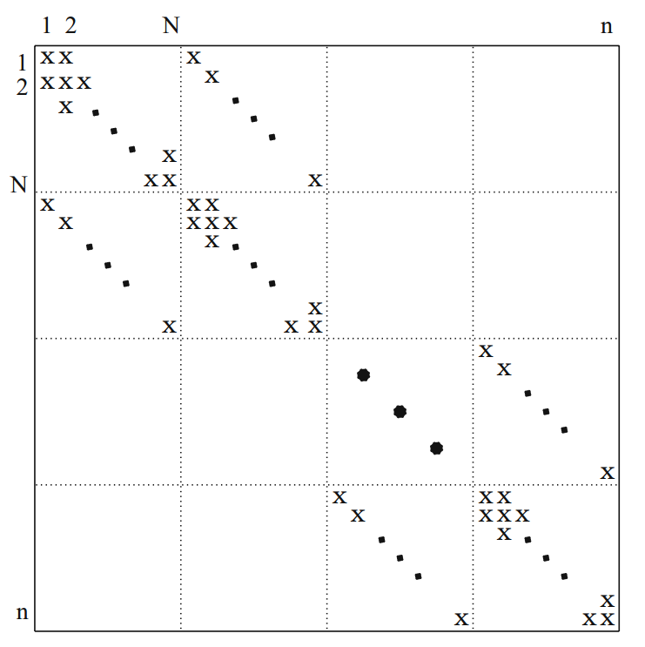
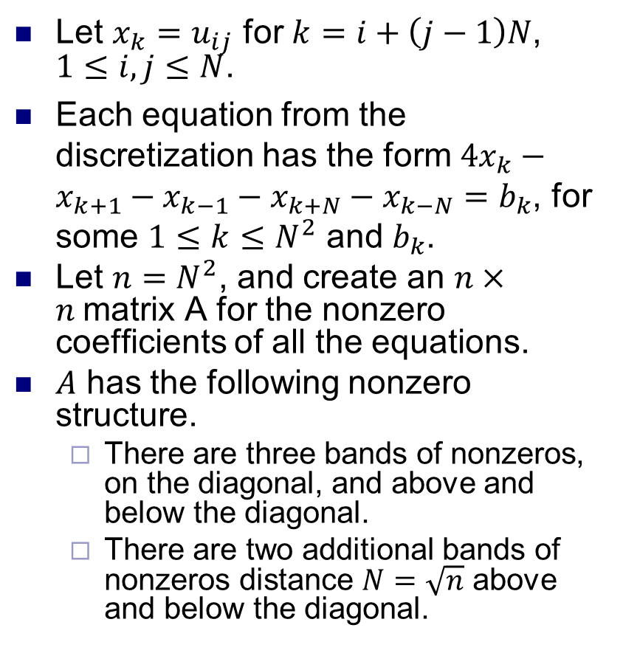
Matrix form of Poisson’s equation
Let $x_{k}=u_{ij}$ for $k=i+\left(j−1\right)N$, $1≤i,j≤N$.
Each equation from the discretization has the form $4x_{k}−x_{k+1}−x_{k−1}−x_{k+N}−x_{k−N}=b_{k}$, for some $1≤k≤N^{2}$ and $b_{k}$.
Let $n=N^{2}$, and create an $n×n$matrix A for the nonzero coefficients of all the equations.
$A$ has the following nonzero structure.
There are three bands of nonzeros, on the diagonal, and above and below the diagonal.
There are two additional bands of nonzeros distance $N=\sqrt{n}$ above and below the diagonal.

Slide 13
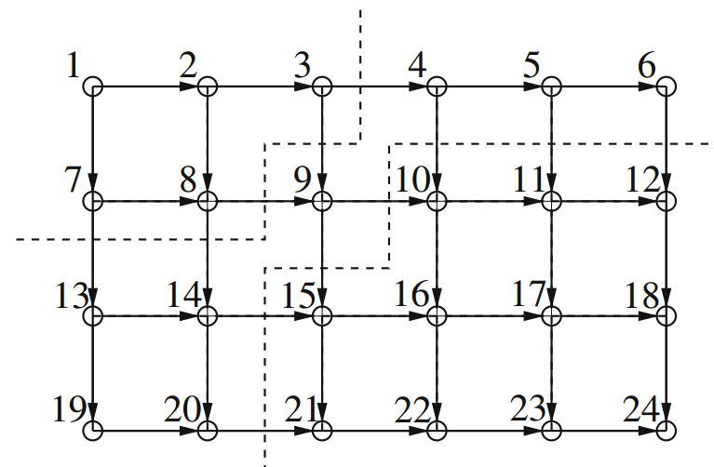
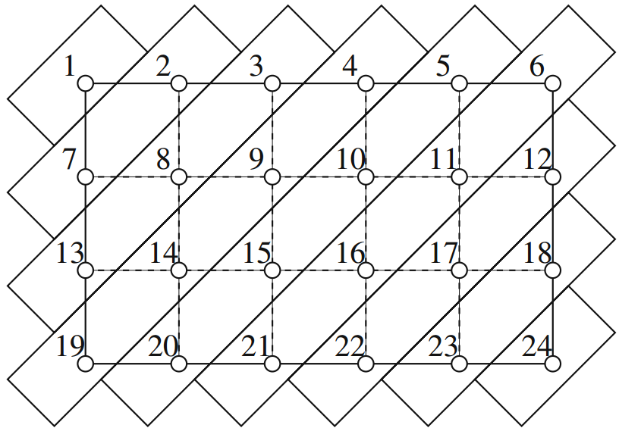
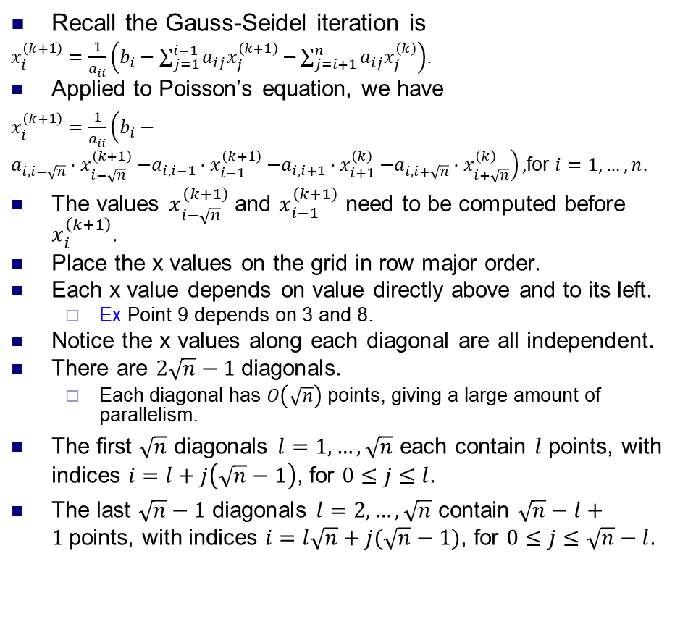
Gauss-Seidel for Poisson’s equation
Recall the Gauss-Seidel iteration is
$x_{i}^{\left(k+1\right)}=\frac{1}{a_{ii}}\left(b_{i}−\sum_{j=1}^{i−1}{a_{ij}x_{j}^{\left(k+1\right)}−}\sum_{j=i+1}^{n}{a_{ij}x_{j}^{\left(k\right)}}\right)$.
Applied to Poisson’s equation, we have
$x_{i}^{\left(k+1\right)}=\frac{1}{a_{ii}}\left(b_{i}−a_{i,i−\sqrt{n}}{⋅x}_{i−\sqrt{n}}^{\left(k+1\right)}−a_{i,i−1}{⋅x}_{i−1}^{\left(k+1\right)}−a_{i,i+1}{⋅x}_{i+1}^{\left(k\right)}−a_{i,i+\sqrt{n}}{⋅x}_{i+\sqrt{n}}^{\left(k\right)}\right),$for $i=1,…,n$.
The values $x_{i−\sqrt{n}}^{\left(k+1\right)}$ and $x_{i−1}^{\left(k+1\right)}$ need to be computed before $x_{i}^{\left(k+1\right)}$.
Place the x values on the grid in row major order.
Each x value depends on value directly above and to its left.
Ex Point 9 depends on 3 and 8.
Notice the x values along each diagonal are all independent.
There are $2\sqrt{n}−1$diagonals.
Each diagonal has $O\left(\sqrt{n}\right)$ points, giving a large amount of parallelism.
The first $\sqrt{n}$ diagonals $l=1,…,\sqrt{n}$ each contain $l$ points, with indices $i=l+j\left(\sqrt{n}−1\right)$, for $0≤j≤l$.
The last $\sqrt{n}−1$ diagonals $l=2,…,\sqrt{n}$ contain $\sqrt{n}−l+1$points, with indices $i=l\sqrt{n}+j(\sqrt{n}−1)$, for $0≤j≤\sqrt{n}−l$.

Slide 14
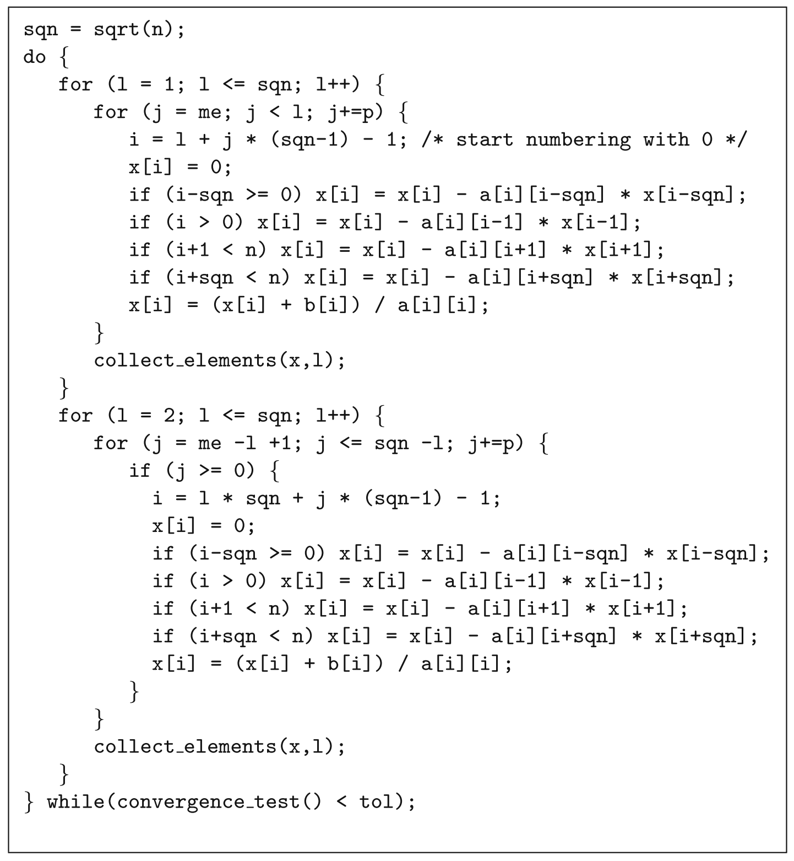
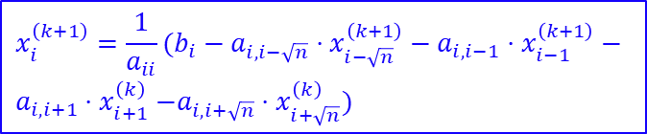
Gauss-Seidel for Poisson’s equation
We parallelize Gauss-Seidel for Poisson’s equation by iterating through the diagonals sequentially, and computing all the values in each diagonal in parallel.
Given p processors, each processor computes every p’th value x[i] on the l’th diagonal.
Notice the sizes of the diagonals first increases, then decreases.
The two for loops compute x during the increasing and decreasing phase, resp.
The function collect_elements sends the x values from the l’th diagonal to neighboring processors to compute the l+1’st diagonal.
Repeat the do loop until x converges.
$$x_{i}^{\left(k+1\right)}=\frac{1}{a_{ii}}(b_{i}−a_{i,i−\sqrt{n}}{⋅x}_{i−\sqrt{n}}^{\left(k+1\right)}− a_{i,i−1}{⋅x}_{i−1}^{\left(k+1\right)}−$$
$$a_{i,i+1}{⋅x}_{i+1}^{\left(k\right)}−a_{i,i+\sqrt{n}}{⋅x}_{i+\sqrt{n}}^{\left(k\right)})$$

Slide 15
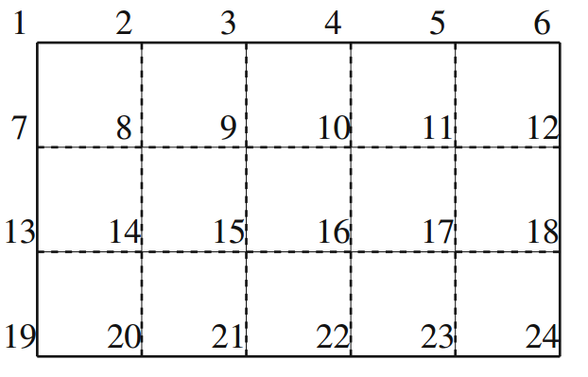
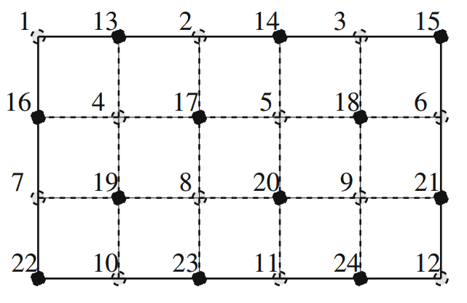
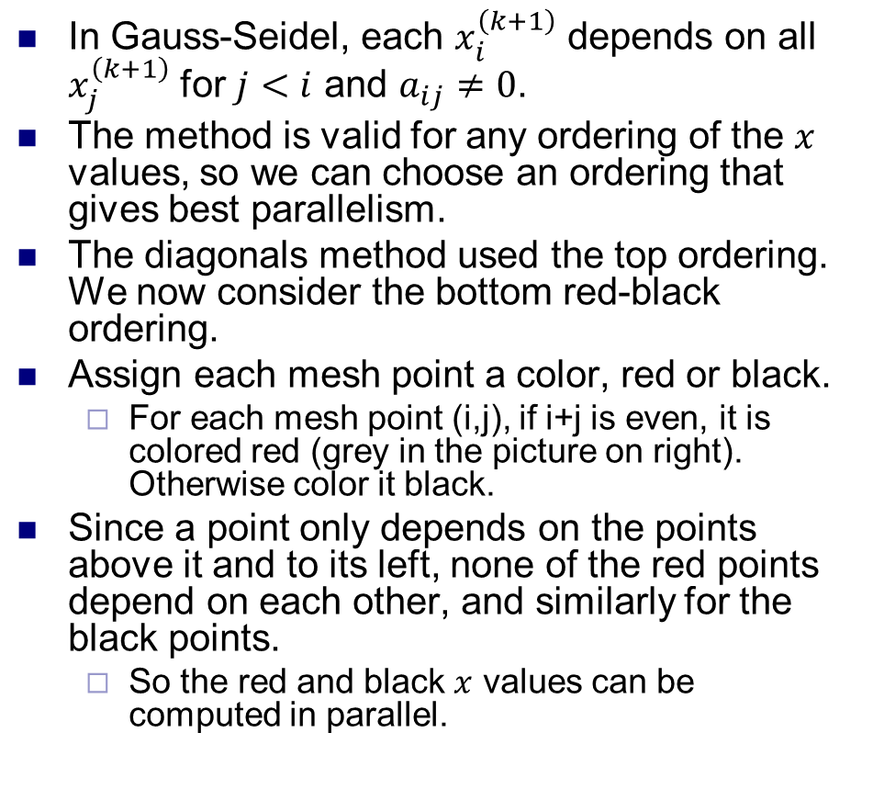
Red-black ordering
In Gauss-Seidel, each $x_{i}^{\left(k+1\right)}$ depends on all $x_{j}^{\left(k+1\right)}$ for $j<i$ and $a_{ij}≠0$.
The method is valid for any ordering of the $x$ values, so we can choose an ordering that gives best parallelism.
The diagonals method used the top ordering. We now consider the bottom red-black ordering.
Assign each mesh point a color, red or black.
For each mesh point (i,j), if i+j is even, it is colored red (grey in the picture on right). Otherwise color it black.
Since a point only depends on the points above it and to its left, none of the red points depend on each other, and similarly for the black points.
So the red and black $x$ values can be computed in parallel.

Slide 16
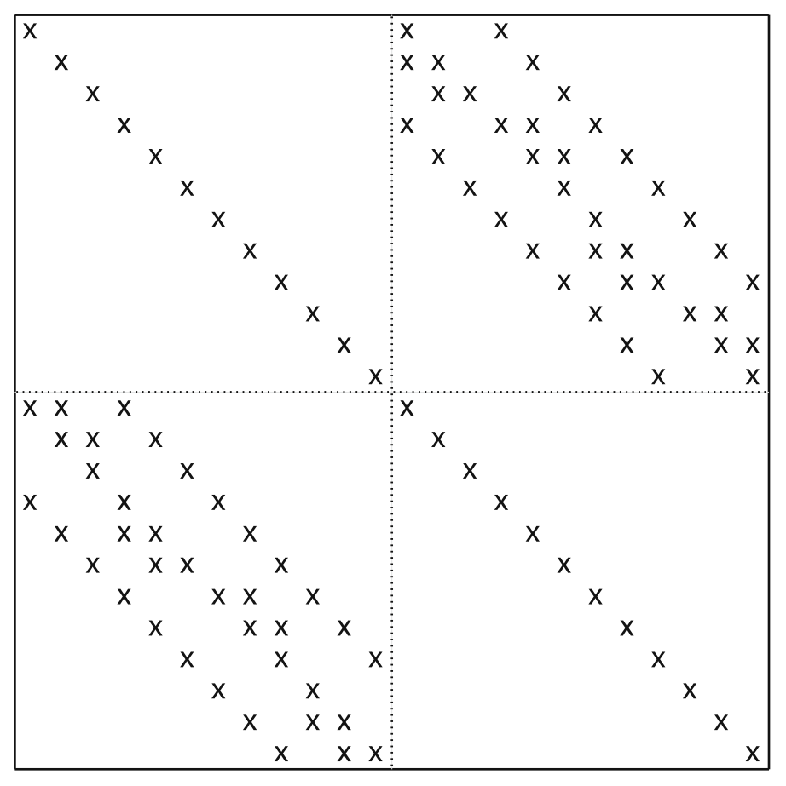
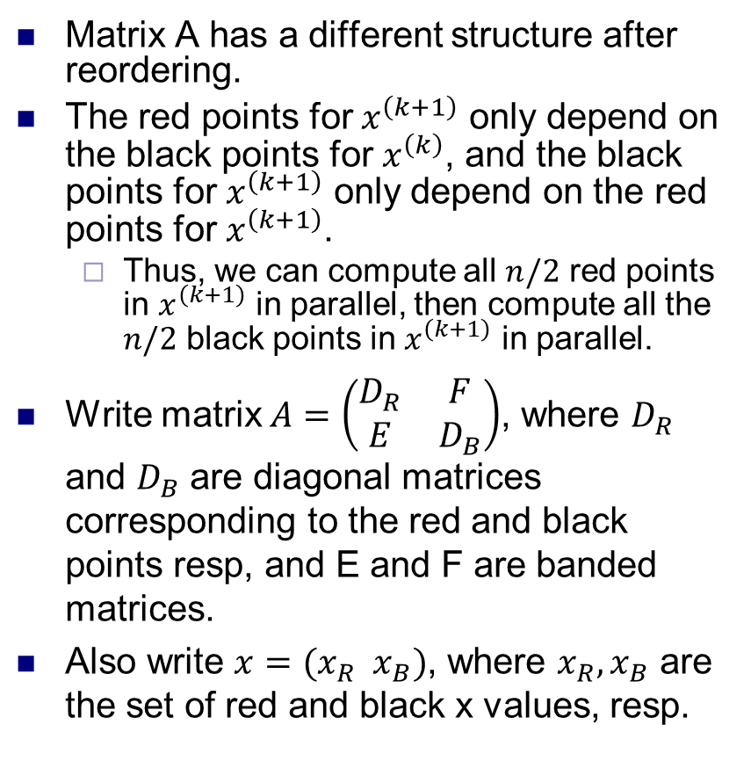
Red-black ordering
Red
Black
Matrix A has a different structure after reordering.
The red points for $x^{\left(k+1\right)}$ only depend on the black points for $x^{\left(k\right)}$, and the black points for $x^{\left(k+1\right)}$ only depend on the red points for $x^{\left(k+1\right)}$.
Thus, we can compute all $n/2$ red points in $x^{\left(k+1\right)}$ in parallel, then compute all the $n/2$ black points in $x^{\left(k+1\right)}$ in parallel.
Write matrix $A=\left(\begin{matrix}D_{R} & F \\ E & D_{B}\end{matrix}\right)$, where $D_{R}$ and $D_{B}$ are diagonal matrices corresponding to the red and black points resp, and E and F are banded matrices.
Also write $x=(x_{R} x_{B})$, where $x_{R}, x_{B}$ are the set of red and black x values, resp.
Red
Black

Slide 17
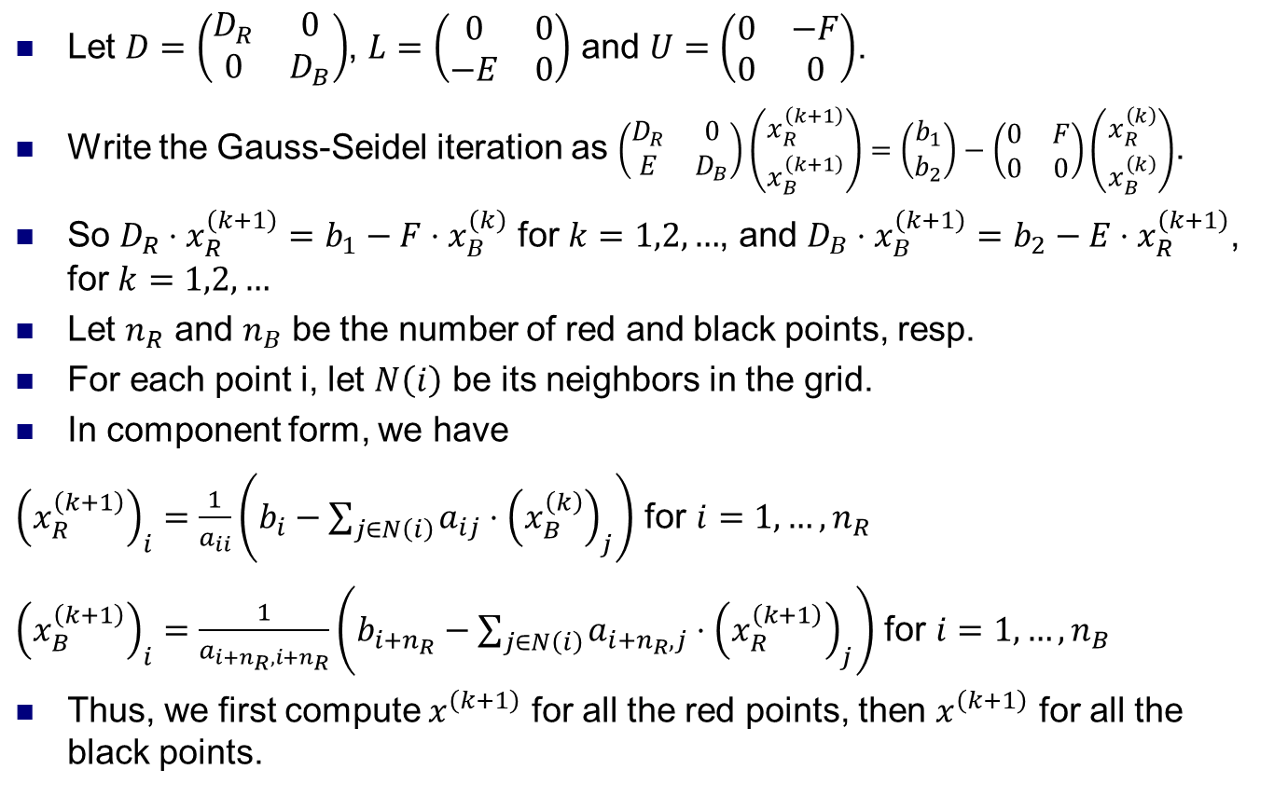
Red-black ordering
Let $D=\left(\begin{matrix}D_{R} & 0 \\ 0 & D_{B}\end{matrix}\right)$, $L=\left(\begin{matrix}0 & 0 \\ −E & 0\end{matrix}\right)$ and $U=\left(\begin{matrix}0 & −F \\ 0 & 0\end{matrix}\right)$.
Write the Gauss-Seidel iteration as $\left(\begin{matrix}D_{R} & 0 \\ E & D_{B}\end{matrix}\right)\left(\begin{aligned}x_{R}^{\left(k+1\right)} \\ x_{B}^{\left(k+1\right)}\end{aligned}\right)=\left(\begin{aligned}b_{1} \\ b_{2}\end{aligned}\right)−\left(\begin{matrix}0 & F \\ 0 & 0\end{matrix}\right)\left(\begin{aligned}x_{R}^{\left(k\right)} \\ x_{B}^{\left(k\right)}\end{aligned}\right)$.
So $D_{R}⋅x_{R}^{\left(k+1\right)}=b_{1}−F⋅x_{B}^{\left(k\right)}$ for $k=1,2,…$, and $D_{B}⋅x_{B}^{\left(k+1\right)}=b_{2}−E⋅x_{R}^{\left(k+1\right)}$, for $k=1,2,…$
Let $n_{R}$ and $n_{B}$ be the number of red and black points, resp.
For each point i, let $N\left(i\right)$ be its neighbors in the grid.
In component form, we have
${\left(x_{R}^{\left(k+1\right)}\right)}_{i}=\frac{1}{a_{ii}}\left(b_{i}−\sum_{j∈N\left(i\right)}{a_{ij}⋅{\left(x_{B}^{\left(k\right)}\right)}_{j}}\right)$ for $i=1,…,n_{R}$
${\left(x_{B}^{\left(k+1\right)}\right)}_{i}=\frac{1}{a_{i+n_{R},i+n_{R}}}\left(b_{i+n_{R}}−\sum_{j∈N\left(i\right)}{a_{i+n_{R},j}⋅{\left(x_{R}^{\left(k+1\right)}\right)}_{j}}\right)$ for $i=1,…,n_{B}$
Thus, we first compute $x^{\left(k+1\right)}$ for all the red points, then $x^{\left(k+1\right)}$ for all the black points.

Slide 18
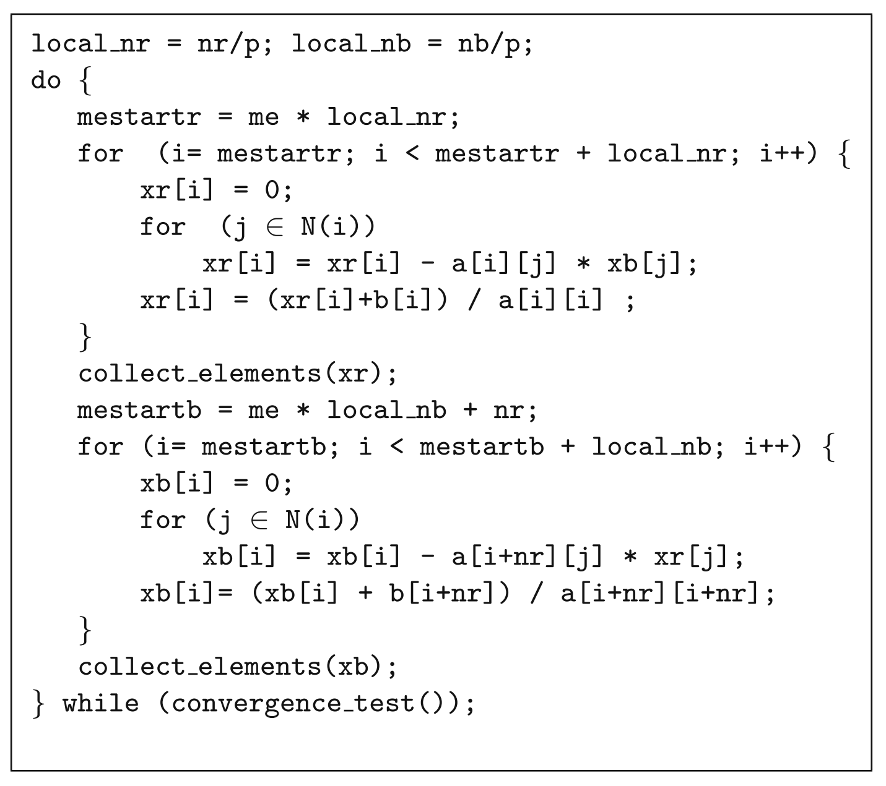
Parallel red-black algorithm
Use a block row-wise decomposition of A and x across the processors.
Use barrier synchronization between the two loops to compute black values after red ones.
collect_elements sends newly computed values of x that lie on the boundary between two processors to the other processor.

